Slide 1
TRAFFITIZER-EMERGENCY RESPONSE SYSTEM
Batch – C9
SHIVARAM.K (16C11A05B0)
SAMRAJ.M (16C11A05A2)
VIVEK KUMAR.K (16C11A05E6)
GOPINATH.G (17C15A0502)
Under the guidance of
Mr. K.VIJAY KUMAR M.Tech
Assistant Professor

Slide 2
ABSTRACT
According to Times of India about 1,46,133 people died in road accidents in India in the year 2016. Unfortunately, about 30% of deaths are caused due to delayed ambulance. An immediate and quick treatment to a patient can save his/her life. So, why not try our best to save lives? Hence, to leverage the above fact, the proposed model will solve one of the major issues faced in ambulance vehicle patient transportation system in different areas.

Slide 3
It has a hardware-software module that can be connected to the traffic control system at any traffic junction. The proposed expert system is based on the Internet of Things (IoT) and image processing, which will help to take proactive and preventive actions to minimize the loss of patients’ lives due to traffic congestion.

Slide 4
Whenever the camera detects an ambulance waiting at a traffic signal, the respective signal changes from stop to go, clearing way for the ambulance to reach its destination on time. Once the ambulance crosses the signal, the signals will act accordingly.

Slide 5
INTRODUCTION

Slide 6
OBJECTIVE
To prevent the ambulance from getting stuck in traffic congestion.
It is a prototype of an intelligent traffic management system that can clear the traffic on the lane where the ambulance is present.
Automatic conversion of signals in other lanes to avoid traffic collision.

Slide 7
PROBLEM STATEMENT
In Urban India, Traffic congestion is a big problem for everyone within the city. The main reasons why traffic congestion occurs are more cars, poor road management, and poor practices.
Everyone wants to reach their destination in time either it may be an emergency or not. What about the critical situation of patients in an ambulance?

Slide 8
So, why not try our best to save lives? Hence, to leverage the above fact, the proposed model will solve one of the major issues faced in ambulance vehicle patient transportation system in different areas.

Slide 9
EXISTING SYSTEM
The current traffic control system (TCS) in the metro cities of India is inefficient due to randomness in the traffic density pattern throughout the day.
The traffic signal timers have a fixed time period to switch traffic between different directions.
Due to this, the vehicles have to wait for a long-time span even if the traffic density is very less.

Slide 10
DRAWBACKS:
More waiting time during emergency situation.
Priority is not given to ambulance during emergency at traffic intersections.

Slide 11
PROPOSED SYSTEM
Traffitizer is a prototype in which if connected to camera, detects an ambulance waiting at a traffic signal, the respective signal changes from red to green, clearing way for the ambulance to reach its destination on time.
The proposed system is based on the Internet of Things (IoT) and image processing, which will help to take proactive and preventive actions to minimize the loss of patient’s lives due to traffic congestion.

Slide 12
Once the ambulance crosses the signal, the signals will act accordingly.
ADVANTAGES:
Automation of traffic during emergency.
Priority given to ambulance at traffic intersections.

Slide 13
ANALYSIS

Slide 14
LITERATURE
During rush hours, emergency vehicles like Ambulances, Police cars and Fire Brigade trucks get stuck in jams. Due to this, these emergency vehicles are not able to reach their destinations in time, resulting into a loss of human lives.
We have developed a system which is used to provide clearance to any emergency vehicle by turning all the red lights to green on the path of the emergency vehicle, hence providing a complete green wave to the desired vehicle.

Slide 15
A 'green wave' is the synchronization of the green phase of traffic signals. With a 'green wave' setup, a vehicle passing through a green signal will continue to receive green signals as it travels down the road. Around the world, green waves are used to great effect.

Slide 16
CURRENT TRAFFIC CONTROL SYSTEM :
The current traffic control system (TCS) in the metro cities of India is inefficient due to randomness in the traffic density pattern throughout the day. The traffic signal timers have a fixed time period to switch traffic between different directions. Due to this, the vehicles have to wait for a long-time span even if the traffic density is very less.

Slide 17
At present, the traffic control systems in India, lack intelligence and act as an open-loop control system, with no feedback or sensing network. The objective is to design an intelligent traffic signal control system algorithm with the use of sensing devices and image processing systems.

Slide 18
IMAGE CLASSIFICATION :
Image classification refers to a process in computer vision that can classify an image according to its visual content. For example, an image classification algorithm may be designed to tell if an image contains a human figure or not. While detecting an object is trivial for humans, robust image classification is still a challenge in computer vision applications.

Slide 19
The BoW model is a commonly used method in document classification and natural language processing. In the BoW model, the frequency of the occurrence of each word in the document is used as a parameter for training a machine learning algorithm. In addition to document classification, the BoW model can also be applied to image classification. To apply the BoW model to classify images, we need to extract a set of words (just like in document classification) from the image and count their occurrence.

Slide 20
IOT :
The Internet of things (IoT) is a system of interrelated computing devices, mechanical and digital machines provided with unique identifiers (UIDs) and the ability to transfer data over a network without requiring human-to-human or human-to-computer interaction.

Slide 21
The definition of the Internet of things has evolved due to the convergence of multiple technologies, real-time analytics, machine learning, commodity sensors, and embedded systems. Traditional fields of embedded systems, wireless sensor networks, control systems, automation (including home and building automation), and others all contribute to enabling the Internet of things. In the consumer market, IoT technology is most synonymous.

Slide 22
ARDUINO :
Arduino is an open-source hardware and software company, project and user community that designs and manufactures single-board microcontrollers and microcontroller kits for building digital devices. Its products are licensed under the GNU Lesser General Public License (LGPL) or the GNU General Public License (GPL), permitting the manufacture of Arduino boards and software distribution by anyone. Arduino boards are available commercially in preassembled form or as do-it-yourself (DIY) kits.

Slide 23
Arduino board designs use a variety of microprocessors and controllers. The boards are equipped with sets of digital and analog input/output (I/O) pins that may be interfaced to various expansion boards ('shields') or breadboards (For prototyping) and other circuits. The boards feature serial communications interfaces, including Universal Serial Bus (USB) on some models, which are also used for loading programs from personal computers. The microcontrollers can be programmed using C and C++ programming languages. In addition to using traditional compiler toolchains, the Arduino project provides an integrated development environment (IDE) based on the Processing language project.

Slide 24
IMPLEMENATION SPECIFICATION
HARDWARE:
Processor : Intel i7 @ 2.5 GHZ
RAM : 16 GB
Hard Disk : 1 TB
Arduino : generic 8266
LED : Red, Orange, Green
Resistor : 36 ohms (1)
Bread board : 830 points solderless(1)
.....

Slide 25
SOFTWARE:
Operating system : Windows 10 (64-Bit)
Programming Language : PYTHON 3.7
IDE : PYCHARM 2020.1 , ARDUINO1.0.x
Design Tool : Star UML 5
.....

Slide 26
DESIGN

Slide 27
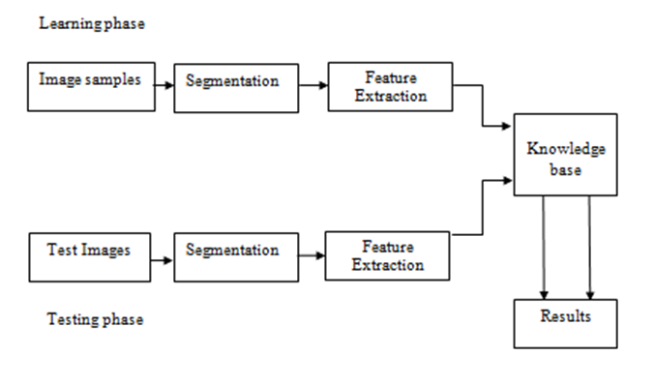
ARCHITECTURE

Slide 28
MODULES
The proposed “TRAFFITIZER-EMERGENCY RESPONSE SYSTEM” system has 1 module:
Admin

Slide 29
ADMIN MODULE
The Admin module consists sub modules:
Train model
Test model
Update model

Slide 30
DESIGN MODELS
The proposed system design models are created by UML
UML stands for Unified Modeling Language
UML consists an integrated set of diagrams, developed to help system and software developers for specifying, visualizing, constructing, and documenting the artifacts of software systems, as well as for business modeling and other non-software systems.

Slide 31
USECASE DIAGRAM
A use case diagram at its simplest is a representation of a user's interaction with the system that shows the relationship between the user and the different use cases in which the user is involved.

Slide 32
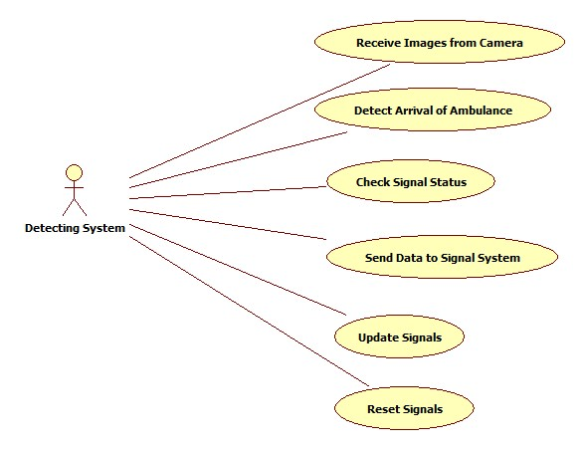
DETECTION SYSTEM-USECASE DIAGRAM

Slide 33
DATA FLOW DIAGRAM
A data flow diagram (DFD) is a significant modeling technique for analyzing and constructing information processes. Data-flow diagram is a graphical representation of the “flow” of data through an information system.

Slide 34
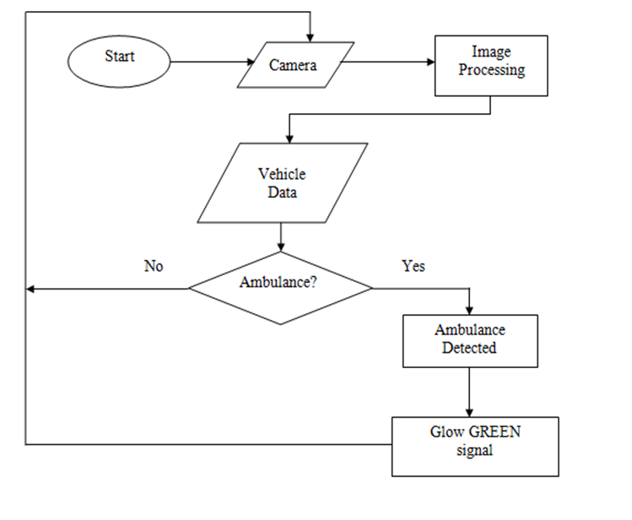
DATA FLOW DIAGRAM

Slide 35
SEQUENCE DIAGRAM
A sequence diagram shows object interactions arranged in time sequence. It depicts the objects and classes involved in the scenario and the sequence of messages exchanged between the objects needed to carry out the functionality of the scenario.

Slide 36
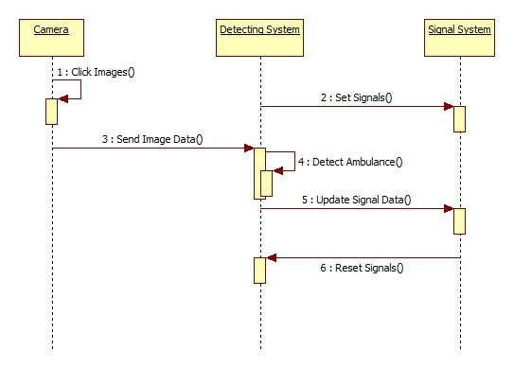
ADMIN-SEQUENCE DIAGRAM

Slide 37
IMPLEMENTATION

Slide 38
TECHNOLOGIES
PYTHON
CASCADE CLASSIFIER
IOT
ARDUINO
CASCADE GUI TRAINER

Slide 39
PYTHON
Python is an interpreted, high-level, general-purpose programming language. Created by Guido van Rossum and first released in 1991, Python's design philosophy emphasizes code readability with its notable use of significant whitespace. Its language constructs and object-oriented approach aim to help programmers write clear, logical code for small and large-scale projects.

Slide 40
Python is dynamically typed and garbage-collected. It supports multiple programming paradigms, including procedural, object-oriented, and functional programming. Python is often described as a "batteries included" language due to its comprehensive standard library.

Slide 41
MACHINE LEARNING
Machine learning (ML) is the scientific study of algorithms and statistical models that computer systems use to perform a specific task without using explicit instructions, relying on patterns and inference instead. It is seen as a subset of artificial intelligence

Slide 42
Machine learning algorithms build a mathematical model based on sample data, known as "training data", in order to make predictions or decisions without being explicitly programmed to perform the task. Machine learning algorithms are used in a wide variety of applications, such as email filtering and computer vision, where it is difficult or infeasible to develop a conventional algorithm for effectively performing the task.

Slide 43
IOT
The Internet of things (IoT) is a system of interrelated computing devices, mechanical and digital machines provided with unique identifiers (UIDs) and the ability to transfer data over a network without requiring human-to-human or human-to-computer interaction.

Slide 44
The definition of the Internet of things has evolved due to the convergence of multiple technologies, real-time analytics, machine learning, commodity sensors, and embedded systems. Traditional fields of embedded systems, wireless sensor networks, control systems, automation (including home and building automation), and others all contribute to enabling the Internet of things.

Slide 45
ARDUINO
Arduino is an open-source hardware and software company, project and user community that designs and manufactures single-board micro controllers and micro controller kits for building digital devices. Its products are licensed under the GNU Lesser General Public License (LGPL) or the GNU General Public License (GPL), permitting the manufacture of Arduino boards and software distribution by anyone. Arduino boards are available commercially in preassembled form or as do-it-yourself (DIY) kits.

Slide 46
CASCADE GUI TRAINER
Cascade Trainer GUI is an application that can be used to create, train, test and improve cascade classifier models. It uses a graphical interface to set the parameters and make it easy to use OpenCV tools for training and testing classifiers.

Slide 47
TESTING

Slide 48
DEBUGGING
The purpose of debugging/testing is to discover errors. Testing is the process of trying to discover every conceivable fault or weakness in a work product.
It is the process of exercising software with the intent of ensuring that the Software system meets its requirements and user expectations and does not fail in an unacceptable manner.
There are various types of test. Each test type addresses a specific testing requirement.

Slide 49
STRATEGIES
TYPES:
Unit Testing
Integration Testing
Functional Testing
System Testing
METHODS:
White Box Testing
Black Box Testing

Slide 50
TEST CASES
TEST CASE No: | INPUTS | EXPECTED OUTPUT | ACTUAL OUTPUT | TEST RESULT
1 | Video with ambulance | Detected ambulance and turn green LED on | Detect ambulance and turn green LED on | Pass
2 | Video without ambulance | No changes in the LED | No changes in the LED | pass

Slide 51
DEPLOYMENT

Slide 52
MINIMUM REQUIREMENTS
HARDWARE:
Processor : Intel i3/ AMD
RAM : 1 GB
Hard Disk : 40 GB
SOFTWARE:
Operating system : Windows 7/Linux/Mac

Slide 53
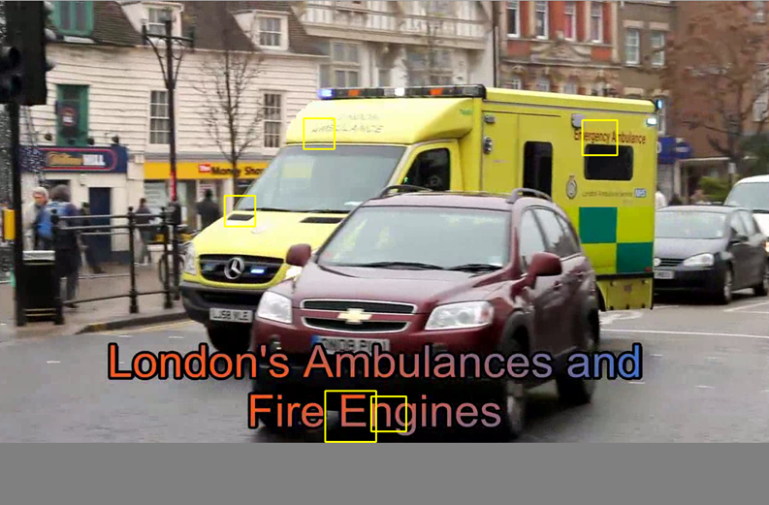
OUTPUT

Slide 54
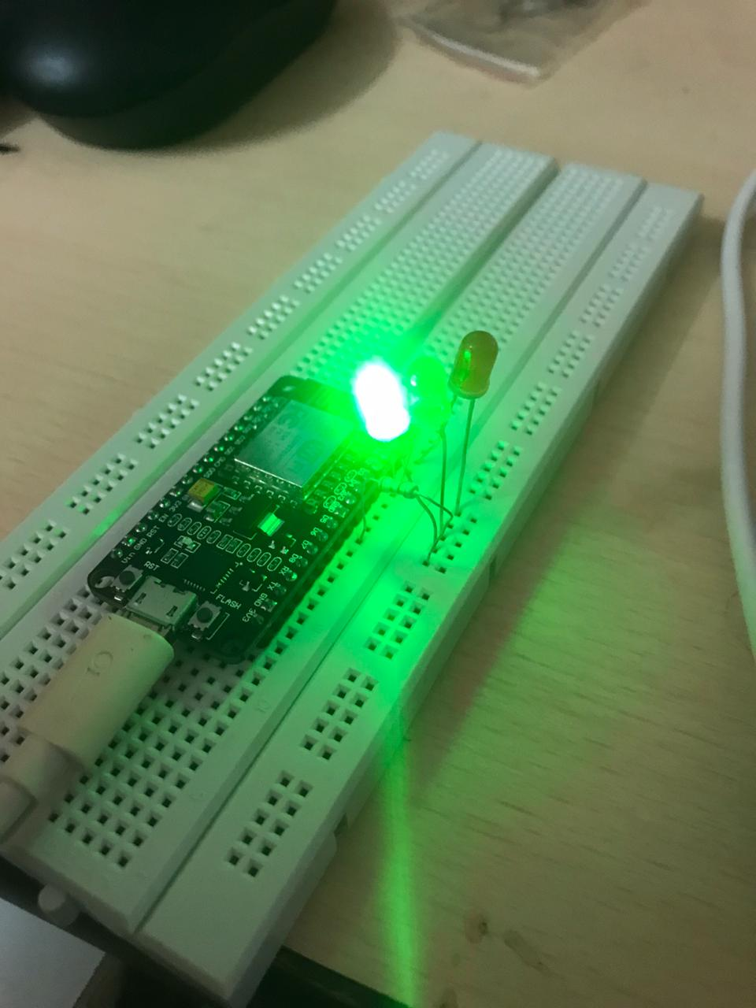

Slide 55
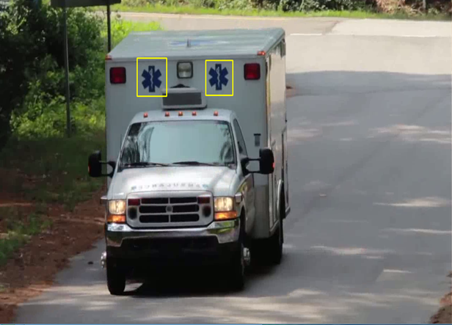
SYMBOL DETECTION

Slide 56
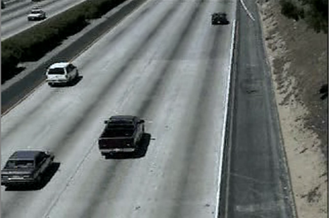
RESULTS No ambulance detected

Slide 57
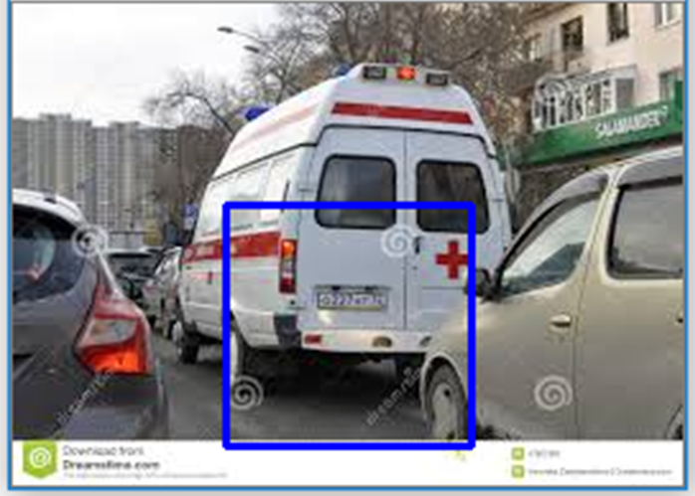
Detecting symbols on ambulance

Slide 58
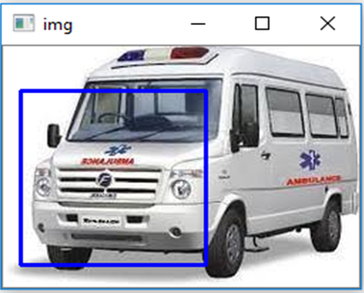
Detecting text and symbols

Slide 59
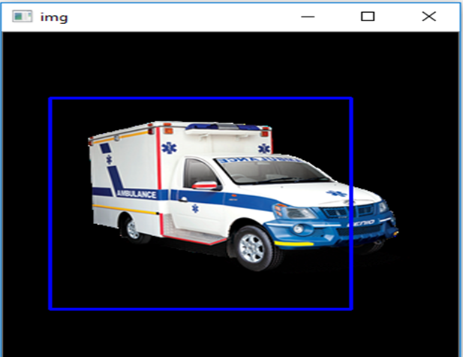
Detecting entire ambulance

Slide 60
CONCLUSION
The proposed system helps to solve the problem of traffic congestion during emergency. The timing of each signal can be automatically adjusted according to the presence of an ambulance clearing the path for the ambulance in emergency cases. It will help patients in taking decisions for reaching their destination in time to avoid wastage of time by an ambulance due to heavy traffic. The automatic changes in traffic signals of a junction can be altered

Slide 61
It is more consistent in detecting ambulance presence because it uses actual traffic images and visualizes the reality, so it functions much better than those systems that rely on the detection of the vehicles metal content. Any type of ambulance can be detected easily by recognizing important criteria like symbol, emergency number, text present on win shield and back window of the ambulance.

Slide 62
FUTURE ENHANCEMENTS
It can be further extended in such a way that the signals can be altered based on the density of the vehicles present in a junction. This can reduce traffic congestion as well as help the ambulance to reach the destination in time.

Slide 63
We can also create an android application which will be used by the ambulance driver. Whenever the driver encounters an emergency case, he can open the app and give the details of the source and destination. The system uses the location of the ambulance and whenever the ambulance moves from one junction to another junction, the respective traffic police will get an alert to clear the path. This can also be helpful for the patients to save their lives.

Slide 64
REFERENCES
Publications:
Ayush Kr. Mittal and Deepika Bhandari., A novel approach to implement Green Wave System and detection of stolen vehicles, Third IEEE International Advance Computing Conference (IACC),2013
Suresh Sharma, A.Pithora, G.Guptha, M.Goel, and M.Sinha published, “A RFID System’’,April,2013.

Slide 65
Text Books:
Rafael C. Gonzalez and Richard E. Woods., Digital Image Processing, Pearson, Fourth Edition,2017
Ravishankar Chityala and Sridevi Pudipeddi., Image Processing and Acquisition using Python,Chapman& Hall/CRC Mathematical and Computational Imaging Sciences Series, First Edition,2014

Slide 66
Web Links:
https://www.geeksforgeeks.org/opencv-python-program-vehicle-detection-video-frame
https://www.pyimagesearch.com/2018/11/12/yolo-object-detection-with-opencv/
https://www.edureka.co/blog/tensorflow-object-detection-tutorial/

Slide 67
THANK YOU

